Slide 1
MECHANICAL VAPOR COMPRESSION (MVC) DESALINATION TECHNIQUE

Slide 2
Vapor-compression (VC) distillation is commonly used for small- and medium-scale desalination units.
There are two methods to compress the vapor: mechanical compressors and steam jets. Mechanical vapor compression is very efficient.
Unlike other distillation systems, it does not require a large external heating source; however, it requires very skilled operators and has higher maintenance costs compared to thermal vapor compression.

Slide 3
Brackish water or seawater entering the evaporators is preheated using sensible heat exchangers that extract thermal energy from the exiting product water and brine.
Steam from the saline solution is transferred from the evaporator to the compressor, which increases the steam pressure and temperature. The high-pressure steam condenses to form distilled water.
The heat of condensation provides the heat of evaporation needed in the saline solution.
The vapor-compression system is explained in Chapter II. This research focuses on optimizing the VC system so it can be more useful in future applications.

Slide 4
Mechanical vapor compression distillation of saline water is a process in which mechanical energy is used as the main driving force.
It is basically a heat pump process that pumps heat from a low-temperature reservoir to a higher temperature reservoir, just as in household refrigerators where the heat is pumped from the air inside the refrigerator box to the ambient air outside of the box. The main elements consist of an evaporator, a condenser, a compressor, and an expansion valve where refrigerants such as Freon or ammonia are used as working fluid in a closed cycle.
The coils inside the refrigerator box form the evaporator and the coils outside the box form the condenser.
Here the working fluid inside the coils in the evaporator, evaporates to absorb heat from inside the box, compressed to raise its saturation pressure and temperature and then enters the condenser coils outside the box to release its latent heat of condensation to the ambient air.
The high-pressure liquid refrigerant then enters the expansion valve where it flashes down to the evaporator pressure to complete the cycle.

Slide 5
In a vapor compression distillation of saline water, the system is not a closed cycle and the basic system consists of the evaporator-condenser and the compressor.
The working fluid is water vapor.
Water vapor generated from the water layer on the evaporation side of the heat transfer surface is compressed to raise its saturation temperature and pressure.
Then condensed on the condensation side of the heat transfer surface, forming condensate and releasing the latent heat of condensation
It is transferred across the heat transfer surface into the water layer on the evaporation side to cause further evaporation of water.
The only energy required to pump the heat content in the vapor from the evaporation side to the condensation side of the heat transfer surface is the mechanical energy required to drive the compressor.

Slide 6
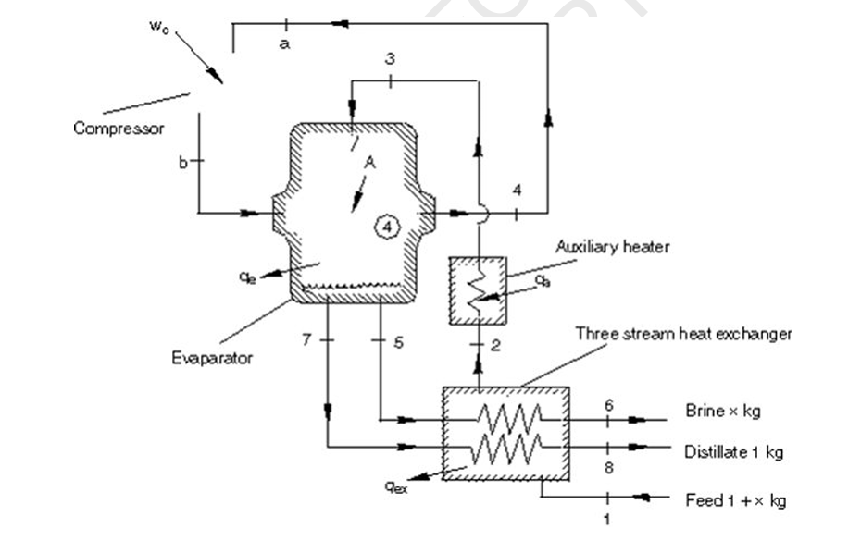

Slide 7
WORKING PROCEDURE
Figure 1 shows a general simplified flow diagram of a basic mechanical vapor compression distillation system. As stated earlier, the system consists of an evaporator condenser, shown as heat transfer A, a mechanically driven vapor compressor, a three stream heat exchanger to pre-heat the feed stream by cooling the distillate and brine streams, and an auxiliary heater to supply additional heat to the feed when needed. For simplicity, pumps and auxiliary equipment are not shown here.
In this system the feed enters the three-stream heat exchanger at state point 1, where it is heated to state point 2, and then enters the auxiliary heater to be heated to state point 3, where it enters the evaporation side of the evaporator.

Slide 8
Here the feed is brought into contact with the heat transfer surface A where part of it becomes vapor at state point 4 and the balance is taken out as brine at state point 5, to be cooled in the three-stream exchanger to state point 6.
The vapor generated at state point 4 enters the compressor at state point a where it is compressed to state point b and then enters the condensation side of the evaporator where it condenses on the other side of the heat transfer surface A at state point 7 and is then cooled to state point 8 in the three-stream exchanger.
Chrome extension://efaidnbmnnnibpcajpcglclefindmkaj/https://www.eolss.net/sample-chapters/C07/E6-144-26.pdf

Slide 9
Vapour compression (VC) desalination offers advantages like high thermal efficiency by recycling heat, a small footprint, excellent water quality, and flexibility for different power sources, making it ideal for small-scale and remote applications without requiring large external heat sources.
It also requires minimal pretreatment and produces nearly demineralized water directly from seawater, reducing operating costs and offering flexibility in product water temperature

Slide 10
ADVANTAGES
High Energy Efficiency: VC systems are thermodynamically efficient because they continuously reuse the heat generated within the system, akin to a heat pump, significantly reducing operating costs.
High Water Quality: The desalination process produces high-purity, nearly demineralized water directly, often suitable for industrial applications or boiler feed without needing additional polishing units.
Flexibility in Power Source: VCD can be powered by electricity or a diesel engine, making it a versatile option for various locations, including ships, islands, and resorts where grid electricity may not be readily available.
Small Footprint: Compared to other distillation systems, VC systems are compact and take up less space, saving on land costs and making them suitable for space-constrained environments.

Slide 11
Minimal Pretreatment: The process can handle softened, dechlorinated water directly, reducing the need for complex and costly pretreatment processes.
No Need for Large-Scale Heat Sources: Unlike some thermal desalination methods, VC systems do not require large-scale external heat sources, as the required heat is generated internally.
Continuous Operation: The ability to continuously reuse heat ensures a stable and reliable supply of purified water.
Suitable for Various Salinity Levels: VC systems can effectively desalinates both highly saline seawater and brackish water.

Slide 12
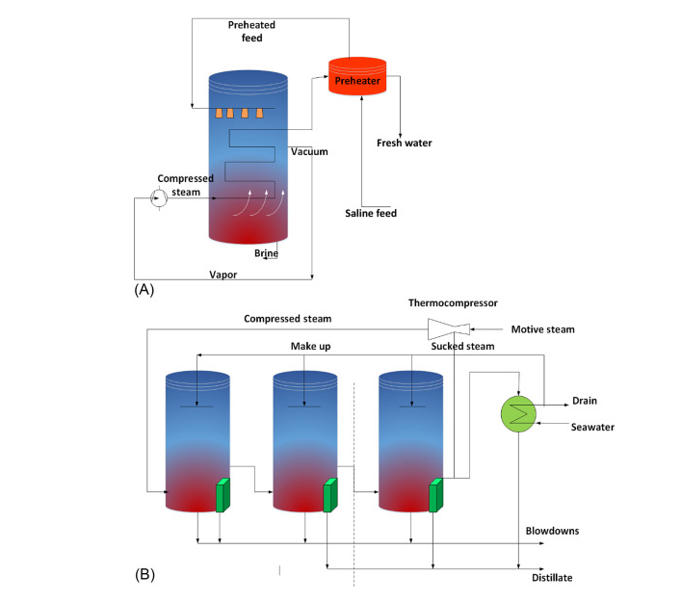

Slide 13
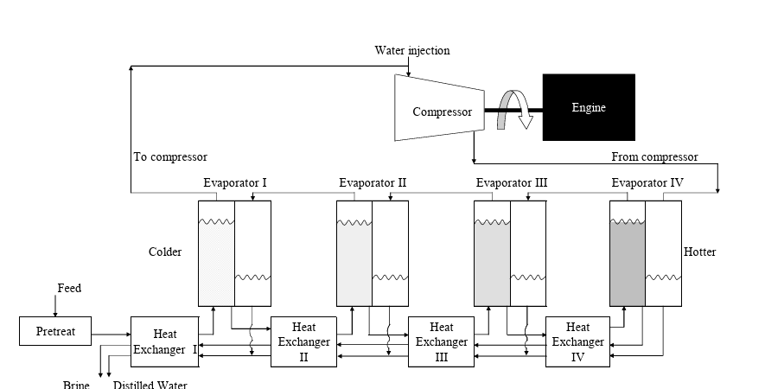
Fig 2. Series vapor-compression desalination.

Slide 14
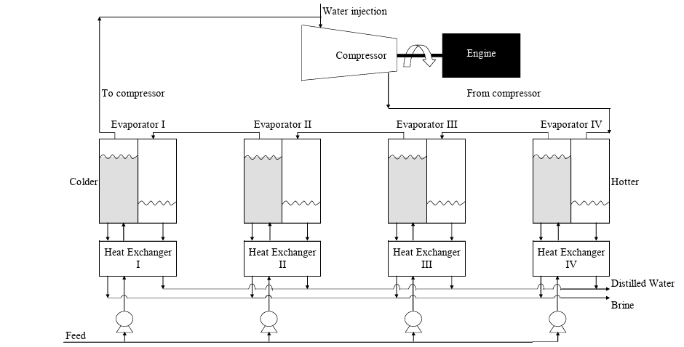
Fig 3: Parallel vapor-compression desalination.

Slide 15
Objectives
The specific objective for this project is to find the recommended operating conditions for the system and to find the optimal cost of potable water ($/thousand gallons).
chromeextension://efaidnbmnnnibpcajpcglclefindmkaj/https://core.ac.uk/download/pdf/4279329.pdf

